Slide 1
# DFT equipment list
No | ITEM | Spec
1 | Digital Function Tester | UHD Grabber
2 | Receiver Pack | HD / FHD
3 | Receiver Pack | UHD (Vby1)
4 | Pattern Generator | MSPG-925
5 | UHD HDMI Generator | MSHG-800
6 | DP Generator | MSDP-500
7 | AV Switch Box | MSSD-47AV
8 | Convertor | SMAV-2000
9 | IP port | T3008
10 | Scanner | LS-4208/RS232
11 | DFT PC | 2in1
12 | Lever Tool | Common
13 | DFT Rack | 2in1
14 | AC Power system | Auto AC Power
15 | IF Pack Container | IF Pack Container
16 | Auto Discharge Controller | ADS-2S
17 | SMPS Box | Common Power
18 | LCD TV | 43“ (43UJ6500)

Slide 2
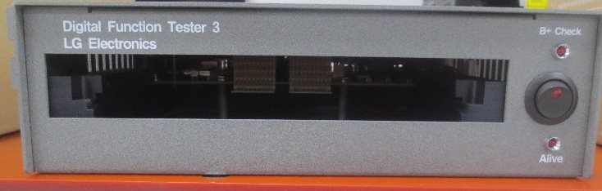
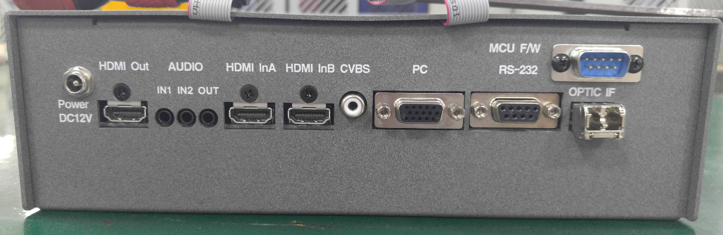
1. Digital Function Tester / UHD Grabber
0. Usage : Image Grabber and capture monitor display LVDS signal to use analyzing the color feature.
1. Features
- Capture LVDS data from target board
- Send LVDS data of target board to PC
[ Front ]
[ REAR ]
Power Switch
B+ Voltage check LED
Interface Pack Slot
2. Maker : LG Electronics

Slide 3
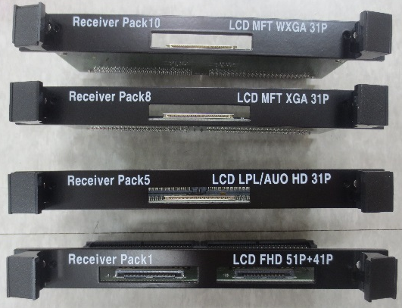
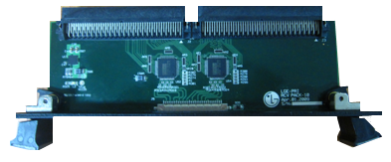
2. Receiver Pack / HD/FHD
0. Usage : To interface various LVDS pin type it’s used in the Grabber(Digital Function Tester).
1. Features
-. Interface Board depends on LVDS Pin map and resolution (HD / FHD)
[ Front ]
[ Top ]
NO | Receiver Pack No | Resolution |  | Pin Q’ty | Memo
1 | # 1 | FHD | 1920 X 1080 | 51 + 41 Pin
2 | # 5 | HD | 1366 X 768 | 31 Pin | B+: No 1~ 4 (Module )
3 | # 8 | HD | 1366 X 768 | 31 Pin | B+ : No 26~30 (Module)
4 | # 10 | FHD | 1920 X 1080 | 31 Pin
2. Maker : LG Electronics

Slide 4
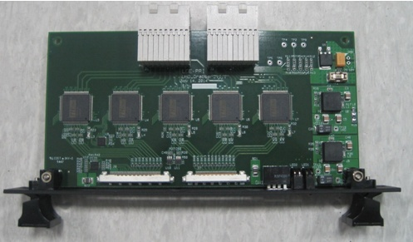
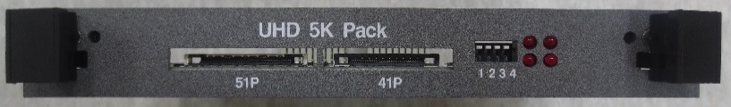
3. Receiver Pack / UHD
0. Usage : To interface various LVDS pin type it’s used in the Grabber(Digital Function Tester).
1. Features
-. Support UHD Resolution Image (3840 X 2160) & Vby1 Interface format
[ Top ]
[ Front ]
NO | Receiver Pack Name | Resolution |  | Pin Q’ty
1 | UHD 5K Pack | UHD | 3840 X 2160 | 51 + 41 Pin
2. Maker : LG Electronics

Slide 5
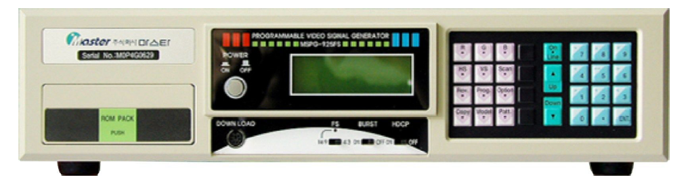
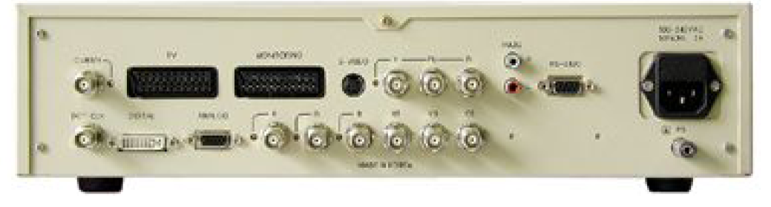
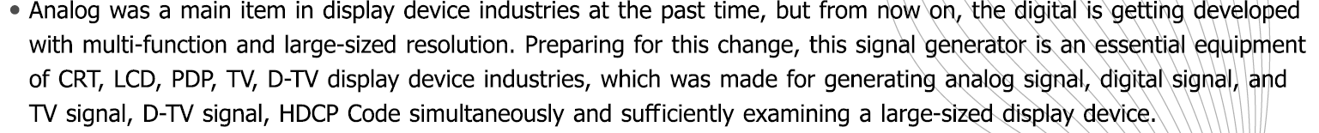
4. Pattern Generator / MSPG-925
0. Usage : Multi Video Signal Generator
[ Front ]
[ REAR ]
Spec Document

Slide 6
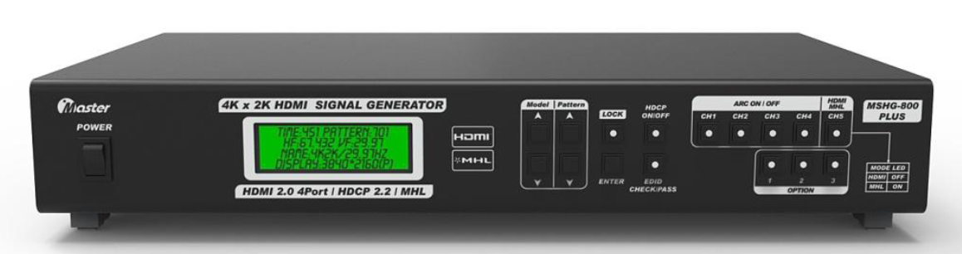
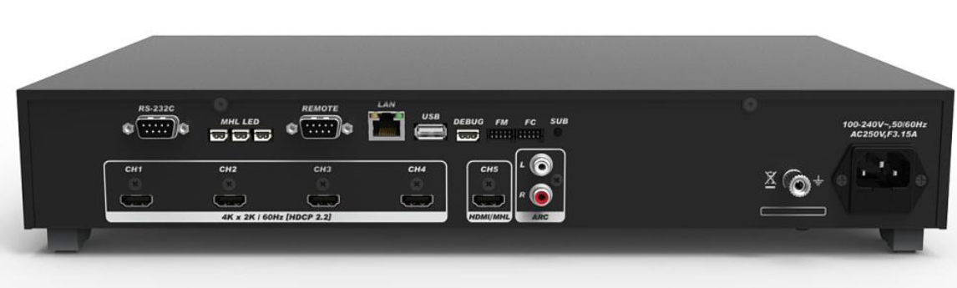
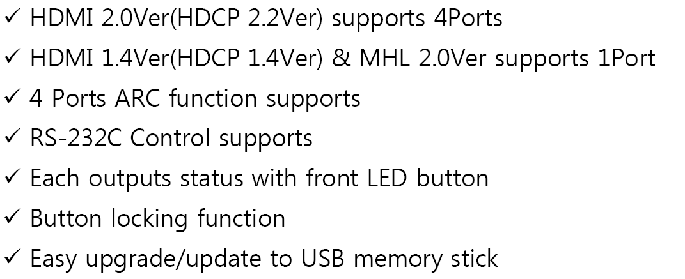
5. UHD HDMI Generator / MSHG-800 Plus
0. Usage : Multi Video Signal Generator
[ Front ]
[ REAR ]
Spec Document

Slide 7
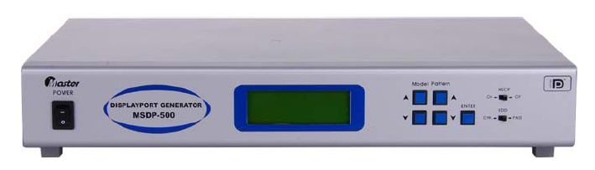
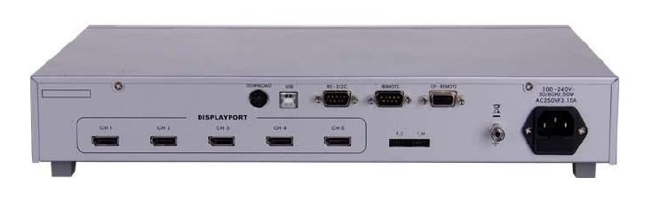
6. DP Generator / MSDP-500
0. Usage : Displayport Signal Generator
[ Front ]
[ REAR ]
Spec Document

Slide 8
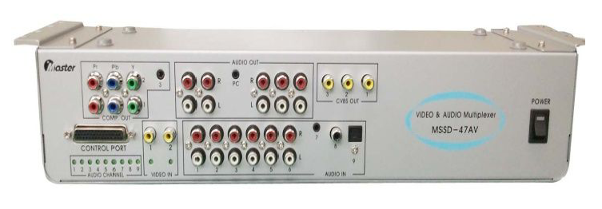
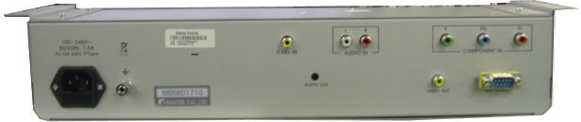
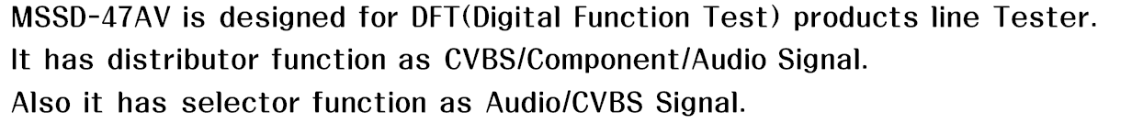
7. AV Switch Box / MSSD-47AV
0. Usage : Distributor function as CVBS/Component/Audio Signal
[ Front ]
[ REAR ]
Spec Document

Slide 9
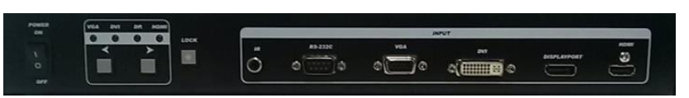
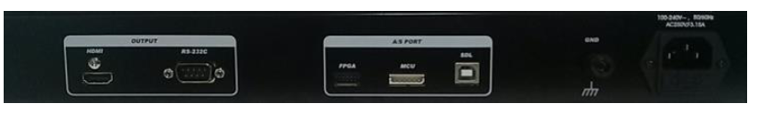
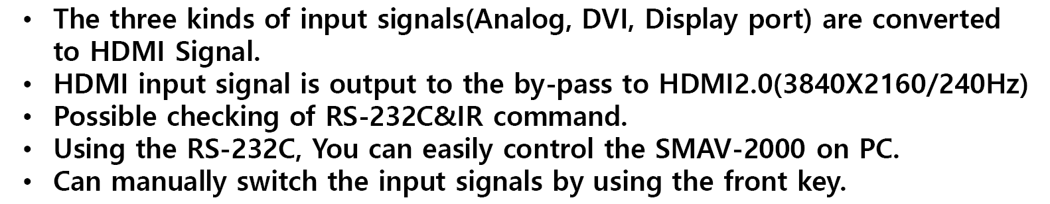
8.Convetor / SMAV-2000
0. Usage : Audio & Video Convertor (Analog/Digital signal to HDMI)
[ Front ]
[ REAR ]
Spec Document

Slide 10
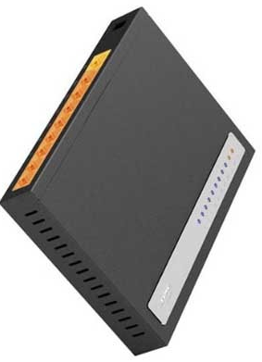
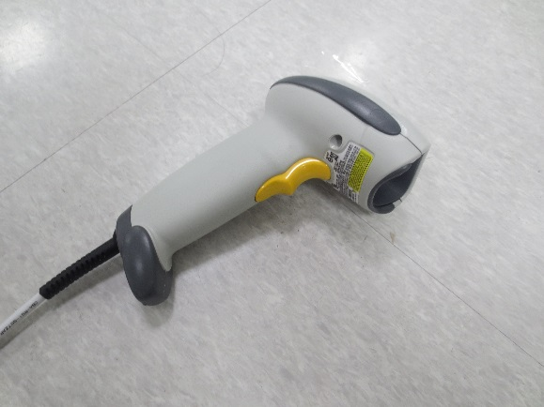
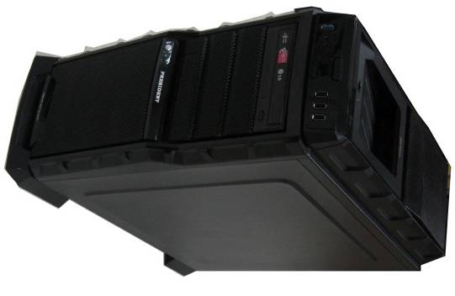
9. IP Port / 10. Scanner / 11. DFT PC
9) IP Port
10) Barcode Scanner
11) DFT PC
- LAN Port 7 ea
- 1000 MBPS
- RS 232 Type
- OS : Window 7 / 64 BIT
- Main Board : ASUS Z270
- CPU : Intel Core i7
- Memory : 8 G
- HDD : 1 TB

Slide 11
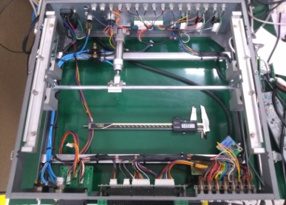
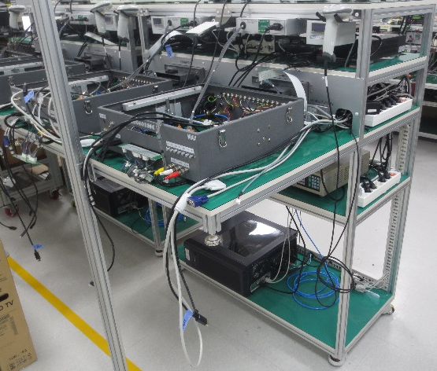
12. Lever Tool / 13. DFT Rack
12) Lever Tool
13) DFT Rack
- Common Jig for main TV/Monitor PCBA
- Working Table
- 2in1 Size

Slide 12
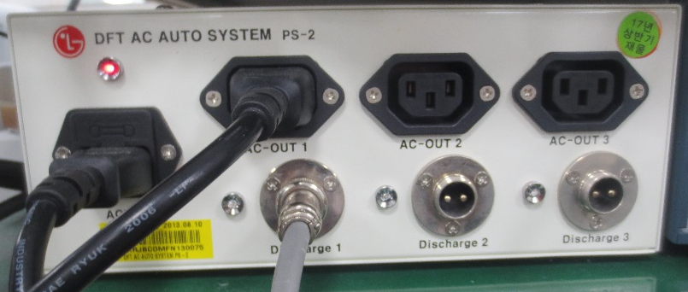
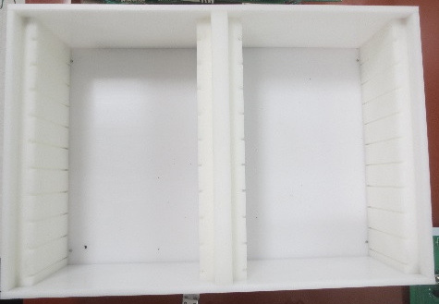
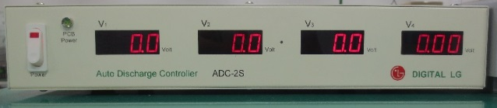
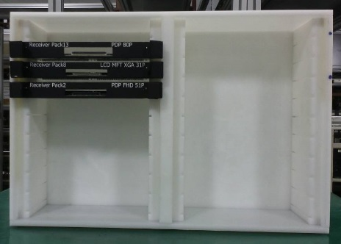
14.AC Power System / 15. IF Pack Container / 16. Auto Discharge Controller
14)AC Power System
15) IF Pack Container
15) Auto Discharge Controller
- Control Auto AC Power on/off
- Input : 1 ea & Output : 3 ea
- Keeping Receiver Pack
- Model name : ADS-2S
- Control auto discharge PCBA
Ex)

Slide 13
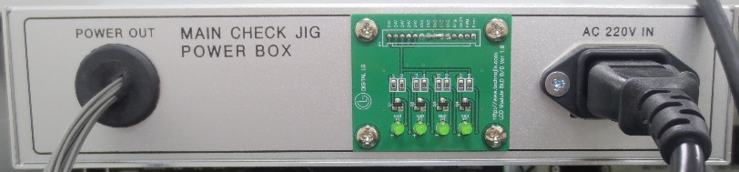
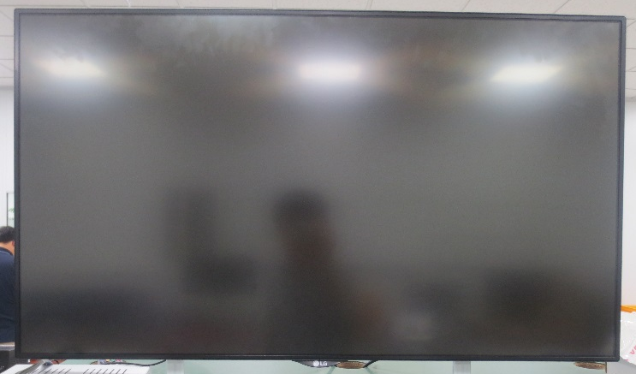
17. SMPS Box / 18. LCD TV
17) SMS Box
16) LCD TV
- Main Check Jig Power Box
- Common Power supply for TV
- Model Name : 43UJ6500
- Display TV for DFT sys.

